Slide 1
Gene expression profile of dermis and epidermis from young and old age group
Alex Gilson
AS.410.671.82
Final Project

Slide 2
Background
This dataset comes from an ongoing investigation from Chung JH & Hwang S, posted to GEO on 11/11/2020.
The goal of the study is “to uncover the genes related to nervous system increased in the process of intrinsic aging”.
Their results thus far point to suspected “hyperinnervation” along with elevated factors of substance P signaling are associated with aging.
They also found 23 genes related to the nervous system were upregulated 2-fold in aged dermis, which I hope to discover as well with the analysis I perform.

Slide 3
Dataset Introduction
Microarray analysis was performed both on the dermis and epidermis of skin tissue from young and old volunteers.
20 samples total from 10 volunteers, the groups being Dermis-Old(OD), Epidermis-Old(OE), Dermis-Young(YD), Epidermis-Young(YE).
The platform used was the (HG-U133_Plus_2) Affymetrix Human Genome U133 Plus 2.0 Array.

Slide 4

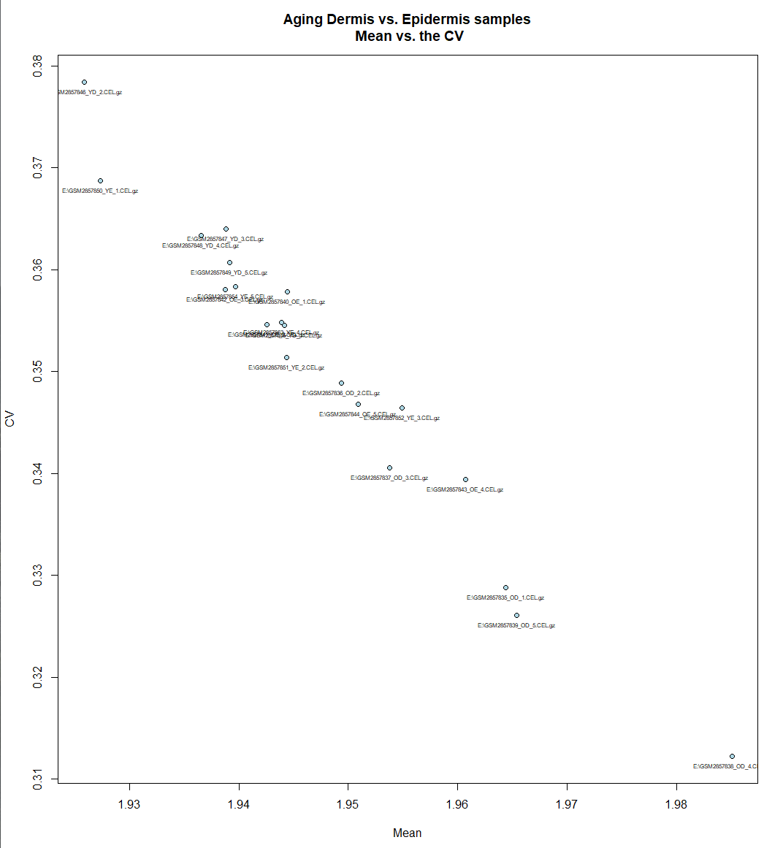
Outliers
A Mean vs. CV plot, Hierarchical Dendrogram, and Average Correlation Plot were calculated to evaluate outlier presence in the dataset.
Through these calculations, it was discovered that the 4th sample of Dermis-Old was an outlier and will be removed from the data set.
See the following slide for further demonstration of this sample as an outlier.

Slide 5
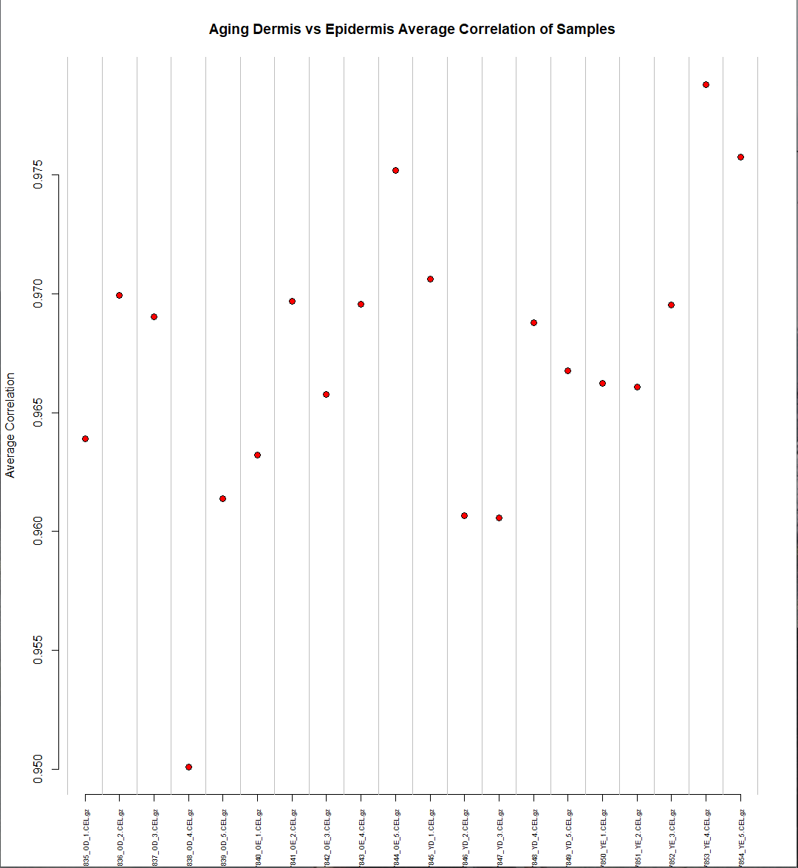
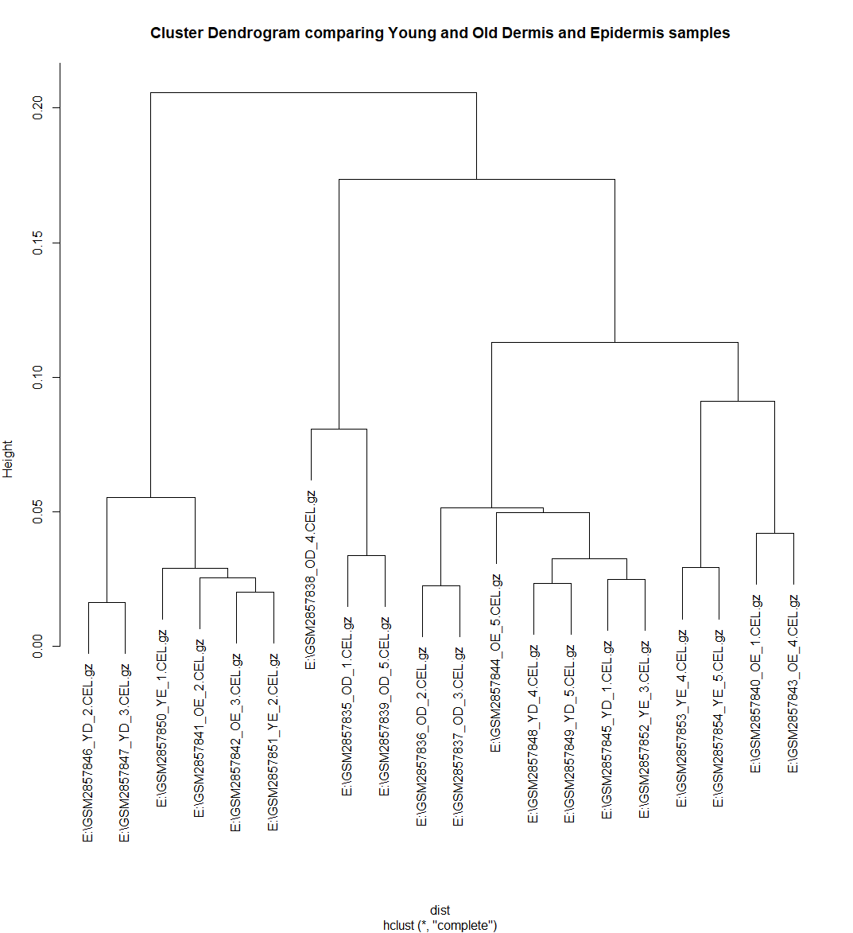
Outliers

Slide 6
Filtering Out Lower Yield Results
Data set for this experiment contains 54,675 genes in total.
According to the rowMeans() function, none of these genes contain expression values less than 1.
> max(dat)
[1] 14.38946
> min(dat)
[1] 1.127204
Therefore, none of the genes will be removed from this data set for having a low yield.

Slide 7
Establishing P-Values comparing Old & Young
Separating the data set into groups of “OD”, “OE”, “YE”, and “YD” for their respective experimental groups, ANOVA was performed on all genes to determine significant differences between the gene expression related to aging.
> four.test.all.genes = function(x,s1,s2,s3,s4){
+ x1 = as.numeric(x[s1])
+ x2 = as.numeric(x[s2])
+ x3 = as.numeric(x[s3])
+ x4 = as.numeric(x[s4])
+ fac = c(rep("A",length(x1)),rep("B",length(x2)),rep("C",length(x3)),rep("D",length(x4)))
+ a.dat=data.frame(as.factor(fac),c(x1,x2,x3,x4))
+ names(a.dat) <- c('factor','express')
+ p.out = summary(aov(express~factor,a.dat))[[1]][1,5]
+ return(p.out)
+ }
> aov.run = apply(dat,1,four.test.all.genes,s1=ann.dat=="OD",s2=ann.dat=="OE", s3=ann.dat=="YD", s4=ann.dat=="YE")

Slide 8
Establishing P-Values comparing Old & Young
A threshold p-value of .005 was used as the number of variables and sample size necessitated examining a smaller p-value for obtaining more accurate results.
3800 genes were identified to have a p-value lower than the threshold when examining the 2 different tissue types and their differences between old and young age.
Further analysis of these genes and their significance will be necessary to determine their relationship with change in expression due to age.

Slide 9
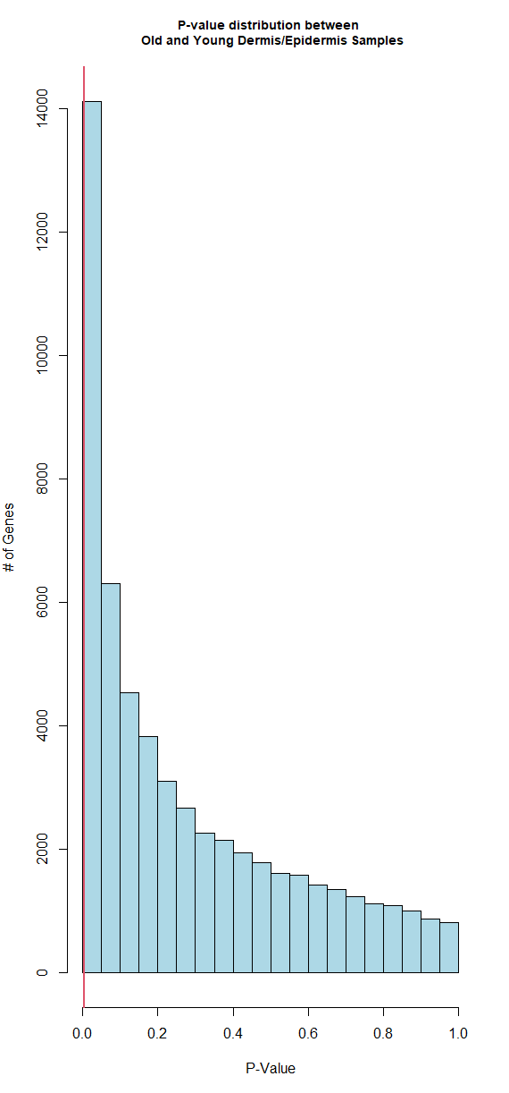
P-Value Histogram
This histogram demonstrates the p-value distribution for all 54,675 genes.
Genes to the left of the red line are those with a p-value lower than .005, the 3800 genes mentioned previously.
These genes’ expression will be the focus for examining differences in the tissues determined by age.

Slide 10
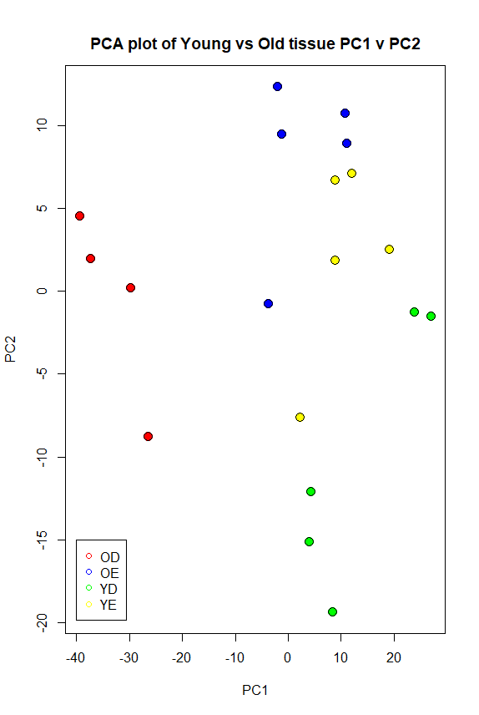
Principal Component Analysis of the 3800 genes
Due to the large amount of genes left to analyze, dimensionality reduction is necessary to visualize the patterns not easily seen in the data.
Principal component analysis of the 3800 genes demonstrates a visual difference between old-dermis(red) and young-dermis(green) expression as seen through their significant distance marked on the plot.
Comparatively, the difference between old-epidermis(blue) and young-epidermis(yellow) is negligible.
These findings suggest the data set presents a change in gene expression from young to old age in dermis tissue samples. Further analysis should be done to evaluate these findings.

Slide 11
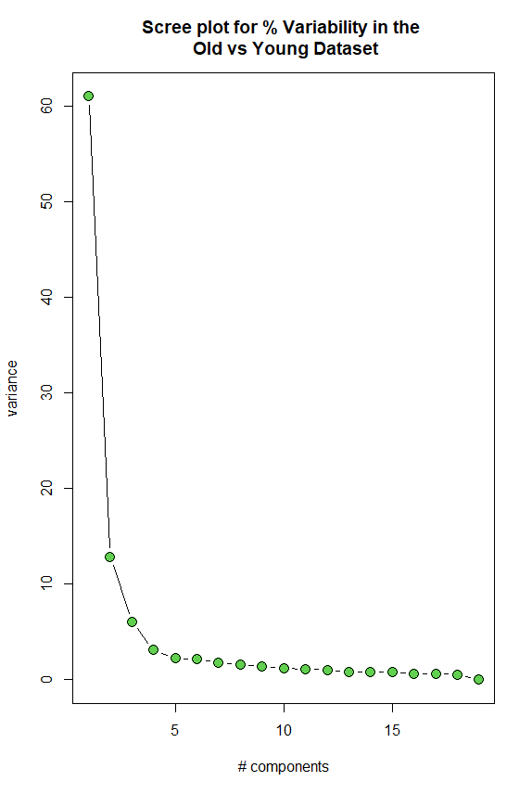
Variability in the dataset
A scree plot was created in order to determine the variability present in the current data set of 3800 genes and how it could have affected the findings from the PCA on the previous slide.
The scree plot demonstrates that PC1 and PC2, which were compared last slide, account for 61.05+12.90= ~74% of the variability explained in the data set.
The scree plot also further solidifies the findings from the PCA as having statistical significance.

Slide 12
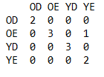
Predicting Class Membership
The data shown in the PCA used already known class membership to draw conclusions from the data. The data shown for that analysis used the samples as the dependent factor, now I want to use the genetic expression data to predict class membership for the samples based on their values for each of the 3800 genes, in order to further determine the significance of these genes in the data set.
Linear Discriminant Analysis(LDA) from the MASS package will be used for class membership prediction. This will provide a visual representation of class membership that can also demonstrate actual class membership
In order to do this, a predictive model must be “trained” to be able to predict class membership for all the 3800 genes. The first 2 samples will be used in each group as a baseline for the prediction test of the data set.
After the prediction was run, a table was printed to show estimates for class membership. This once again demonstrated a relationship between OE and YE that was seen in the PCA plot(see figure on the right for the predicted class table) →

Slide 13
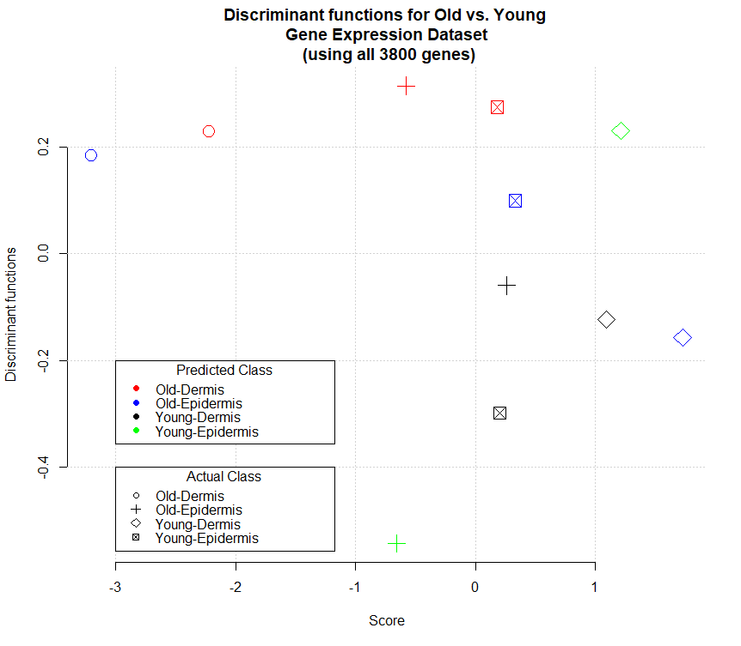
Predicting Class Membership
The LDA prediction was plotted and colored according to the prediction, with the points representing their actual class membership.
This plot shows a great difference in actual class membership and the predicted class membership based on the dataset.
From this information, we can deduce that the 3800 genes and sample groups that were tested for during this analysis did not have enough of a difference for them to be classified into their own respective classes.
YD and OD seem to have their own predicted areas of the plot due and their colors aren’t spread out, but each predicted class on the plot includes multiple different classes from the actual data.

Slide 14
Functional Role of the Most Significant Genes found from the Dataset
Understanding the function of the genes that were most significantly changed during age could help understand the reason behind the change in expression during the aging process. The 10 most significant were taken from the PCA analysis.
These genes were researched in NCBI’s DAVID database to determine their role/function in the tissue.
1560531_at: Late Cornified Envelope 1B(LCE1B)
A precursor to the cornified envelope from the epidermis. Associated pathways involve the formation of the cornified envelope, keratinization, and developmental biology.
1569410_at: Filaggrin Family Member 2(FLG2)
Required for normal cell to cell adhesion in the epidermis. Associated pathways involve the innate immune system(physical skin layer) and neutrophil degranulation.
207710_at: Late Cornified Envelope(LCE2B)
A precursor to the cornified envelope from the epidermis. Associated pathways involve the formation of the cornified envelope, keratinization, and developmental biology.
207720_at: Loricrin(LOR)
This gene is plays a role in producing the major keratinocyte cell envelope protein. Associated pathways include formation of the cornified envelope, keratinization, and developmental biology
Notes:
https://www.genecards.org/cgi-bin/carddisp.pl?gene=LCE1B
https://www.genecards.org/cgi-bin/carddisp.pl?gene=FLG2
https://www.genecards.org/cgi-bin/carddisp.pl?gene=LCE2B
https://www.genecards.org/cgi-bin/carddisp.pl?gene=LORICRIN

Slide 15
Functional Role of the Most Significant Genes found from the Dataset(continued)
207908_at: Keratin 2(KRT2)
Associated with the function of terminal cornification, keratinocyte activation, proliferation and keratinization, as well as establishing the epidermal barrier of the skin. KRT2 is associated with the pathways of developmental biology, keratinization, and cytoskeleton remodeling of keratin filaments.
215704_at: Filaggrin(FLG)
FLG is associated with aggregating keratin intermediate filaments and promotes disulfide-bond formation among the intermediate filaments during differentiation of the mammalian epidermis. Pathways associated with FLG are formation of the cornified envelope, keratinization, and developmental biology.
226926_at: Dermokine(DMKN)
Association with action as a soluble regulator of keratinocyte differentiation. DMKN does not have any known pathways as of this time.
235272_at: Suprabasin(SBSN)
A potential cornified envelope precursor known to be present during differentiation of keratinocytes. Pathways are not yet known, but studies show this gene to be upregulated in esophageal cancers and could be a factor in increased proliferation of tumor cells in that disease(Zhu J. et al, 2016).
235514_at: Aspartic Peptidase, retroviral-like 1(ASPRV1)
240420_at: Arylacetamide Deacetylase like 2(AADACL2)
Enzymatic gene that undergoes autocleavage necessary to activate the protein, expressed mainly in the granular level of the epidermis and in hair follicles. There are no associated pathways to ASPRV1 known at this time.
This gene is part of a group of carboxylic ester hydrolases. Besides this, no further information is listed by NCBI’s DAVID database, as well as no known associated pathways at this time.
Notes:
https://www.genecards.org/cgi-bin/carddisp.pl?gene=KRT2
https://www.genecards.org/cgi-bin/carddisp.pl?gene=FLG
https://www.genecards.org/cgi-bin/carddisp.pl?gene=DMKN
Zhu, J., Wu, G., Li, Q., Gong, H., Song, J., Cao, L., Wu, S., Song, L., & Jiang, L. (2016). Overexpression of Suprabasin is Associated with Proliferation and Tumorigenicity of Esophageal Squamous Cell Carcinoma. Scientific reports, 6, 21549. https://doi.org/10.1038/srep21549
https://www.genecards.org/cgi-bin/carddisp.pl?gene=ASPRV1
https://www.genecards.org/cgi-bin/carddisp.pl?gene=AADACL2

Slide 16
Conclusions
By examining all the data collected from this analysis (the p-value leading to 3800 significant genes, a PCA analysis of those genes showing some relationship between the difference in old and young dermis tissue, and an unclear result of class membership prediction) it is clear that this data set does provide some indication of differences of gene expression between young and old skin tissue.
The PCA analysis showed a very significant distance between the OD and YD groups, and a close relationship between the OE and YE groups. I was hoping the 10 most significant genes that were pulled from the data later during my analysis would be revealed to have dermal layer functions, but instead most of the genes related to the epidermal layer of the skin.
The 10 most significant genes found in the data set all were related to similar gene pathways and functions. The inclusion of the filaggrin gene is particularly exciting due to its relation to the innate immune system of the body (the skin barrier).
However, the 10 most significant genes I found from my own analysis did not match with the reason behind the study being an investigation into changing nerves due to aging. I was not able to find any of the 23 nervous system related genes that the study was able to determine, but perhaps they were part of the 3800 genes I focused on during my analysis, but just were not the most significant.

Slide 17
References
Chung JH & Hwang S. Gene expression profile of dermis and epidermis from young and old age group. Korea Research Institute of Bioscience and Biotechnology. Submitted to GEO 11/15/2017, Last updated 11/13/2020. https://www.ncbi.nlm.nih.gov/geo/query/acc.cgi?acc=GSE106940
https://www.genecards.org/cgi-bin/carddisp.pl?gene=LCE1B
https://www.genecards.org/cgi-bin/carddisp.pl?gene=FLG2
https://www.genecards.org/cgi-bin/carddisp.pl?gene=LCE2B
https://www.genecards.org/cgi-bin/carddisp.pl?gene=LORICRIN
https://www.genecards.org/cgi-bin/carddisp.pl?gene=KRT2
https://www.genecards.org/cgi-bin/carddisp.pl?gene=FLG
https://www.genecards.org/cgi-bin/carddisp.pl?gene=DMKN
Zhu, J., Wu, G., Li, Q., Gong, H., Song, J., Cao, L., Wu, S., Song, L., & Jiang, L. (2016). Overexpression of Suprabasin is Associated with Proliferation and Tumorigenicity of Esophageal Squamous Cell Carcinoma. Scientific reports, 6, 21549. https://doi.org/10.1038/srep21549
https://www.genecards.org/cgi-bin/carddisp.pl?gene=ASPRV1
https://www.genecards.org/cgi-bin/carddisp.pl?gene=AADACL2

